Slide 1


Hot Spicy
PIZZA
The PizzaHut SQL data analysis project involves metrics to optimize performance.
It focuses on querying databases to extract insights .
Advanced techniques like joins, aggregations, and subqueries are used to derive actionable insights.
The project aims to enhance decision-making in marketing, inventory management, and staffing.

Slide 2
Hot Spicy
PIZZA
It contains a database called as PizaaSales.
It contains four tables namely orders,orders details,pizza types and pizzas.
Orders table:-It contains data about order id,order date and order time.
Orders details:-It contains data about pizza id ,quantity,order details id and order id.
Pizza types:-It mainly contains data about pizza name along with there cateogary and ingredients.
Pizzas:-It contains data about pizzas sizes and there prices.

Slide 3
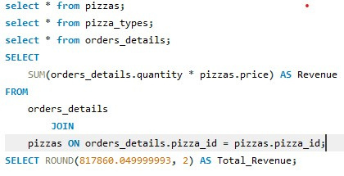
Hot Spicy
PIZZA
Calculate the total revenue generated from pizza sales.

Slide 4
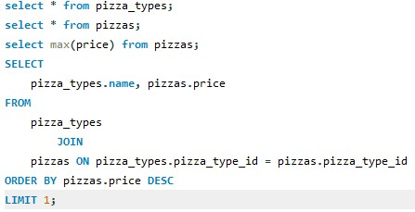
Hot Spicy
PIZZA
Identify the highest-priced pizza.

Slide 5
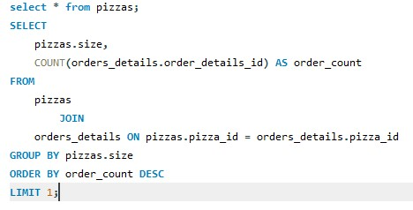
Hot Spicy
PIZZA
Identify the most common pizza size ordered.

Slide 6
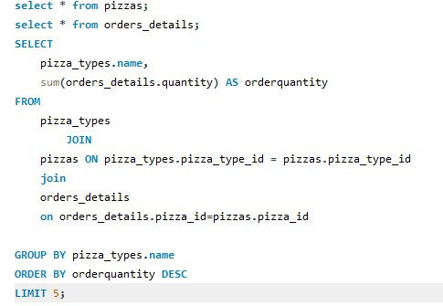
Hot Spicy
PIZZA
List the top 5 most ordered pizza types along with their quantities.

Slide 7
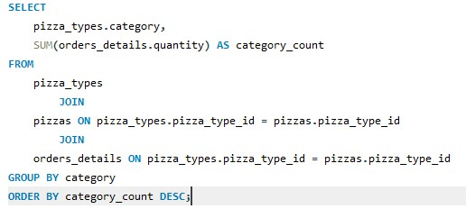
Hot Spicy
PIZZA
Join the necessary tables to find the total quantity of each pizza category ordered

Slide 8
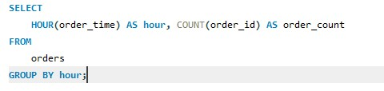
Hot Spicy
PIZZA
Determine the distribution of orders by hour of the day.

Slide 9
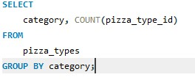
Hot Spicy
PIZZA
Join relevant tables to find the category-wise distribution of pizzas.

Slide 10
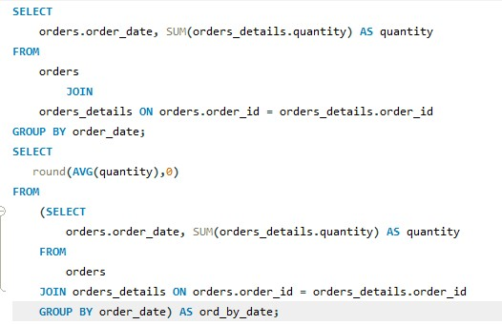
Hot Spicy
PIZZA
Group the orders by date and calculate the average number of pizzas ordered per day.

Slide 11
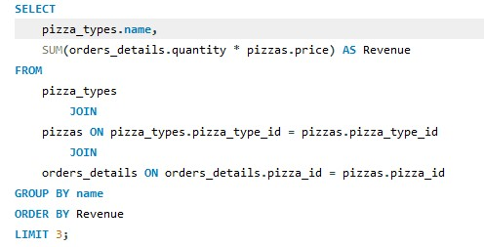
Hot Spicy
PIZZA
Determine the top 3 most ordered pizza types based on revenue.

Slide 12
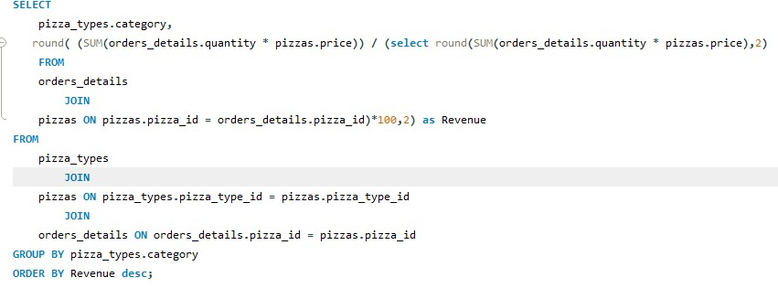
Hot Spicy
PIZZA
Calculate the percentage contribution of each pizza type to total revenue.

Slide 13
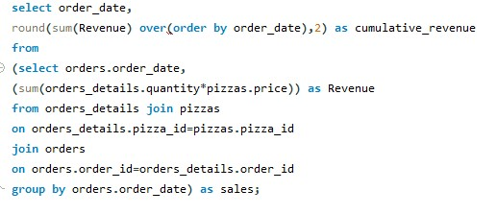
Hot Spicy
PIZZA
Analyze the cumulative revenue generated over time.

Slide 14
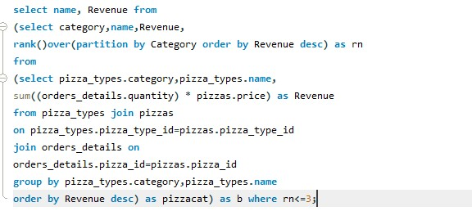
Hot Spicy
PIZZA
Determine the top 3 most ordered pizza types based on revenue for each pizza category.

Slide 15
Hot Spicy
PIZZA
THANK YOU

